Slide 1
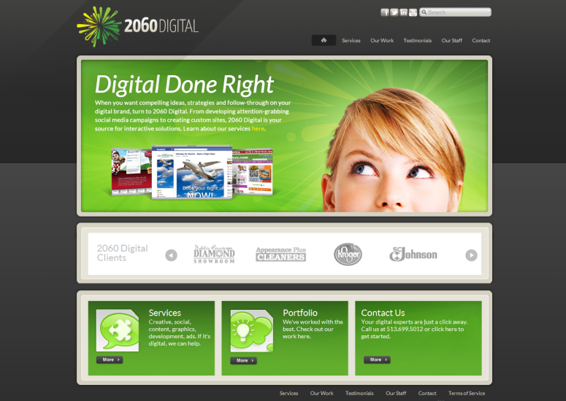
Social Media Management
Notes:
Introduction slide

Slide 2
Why Engage in Social Media?
EVERYONE IS USING IT
Your customers are on social networks DAILY! There are OVER 1 billion monthly active Facebook users, half of which are using Facebook on a daily basis.
According to Facebook ad marketplace there is an estimated 1,067,260 people on Facebook that live within 50 miles of Cincinnati. More than half of these people log on daily for an average of 30 minutes each.
Source: Nielsen; http://thenextweb.com/facebook/2012/10/04/facebook-hits-1-billion-active-users/?utm_source=newsletter&utm_medium=email&utm_campaign=breakingnews

Slide 3
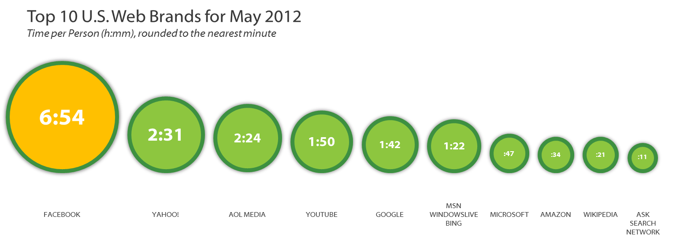
Why Engage in Social Media?
PEOPLE ARE SEARCHING FOR YOU ON SOCIAL MEDIA U.S Internet Users Spend More Time on Facebook than Any Other Web Brand
Source: Nielsen

Slide 4
Why Engage in Social Media?
IT’S THE NEW WORD OF MOUTH MARKETING
Having a social presence allows you to effectively target your most valuable and profitable customers. 79% of Facebook fans are significantly more likely to purchase and recommend your products or services.
IF YOU DON’T HAVE A PRESENCE, YOU HAVE
NO WAY TO GUIDE THE CONVERSATION
The conversation is happening every day on Facebook, Twitter, YouTube, Pinterest, etc. and if you aren’t actively engaging, you have no influence on the discussion.
Source: Nielsen; http://socialcommercetoday.com/statistics-say-facebook-fans-are-your-most-valuable-customers/

Slide 5
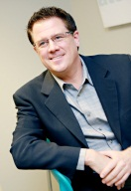
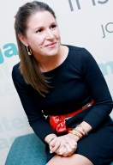
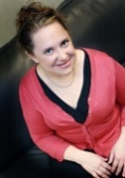
Why work with 2060 Digital? We have the EXPERTISE.
Stephanie Tobias
Director of Digital Operations
Rob McCracken
Director of Business
Development & Strategy
Hillary Kelly
Social and Digital
Consultant
Julie Hauck
Director of Social Media Strategy
Robin Griteman
Client Content Manager
Jeanette McClellan
Consultant
Michael Woodson
Social Media Strategist
Liz Kauffmann
Social Media Manager
Juan Valle
Social Media Strategist
Amy Oliver
Social Media Strategist
Erica Thompson
Social Media Strategist
Gary Kelley
Senior Designer/
Development Specialist
Ryan Benhase
Web/Systems
Developer
Carrie Emig
Digital Designer
Katie Billhimer
Digital Designer
Greg Isaacs
Digital Designer
Bud Stross
Videographer
Michelle Jata
Client Services Director, HalfPriceCincy Specialist
Megan Fenno
Senior Lifestyle
Editor

Slide 6
Why work with 2060 Digital? We have the proven track record.
Notes:
Client logos

Slide 7
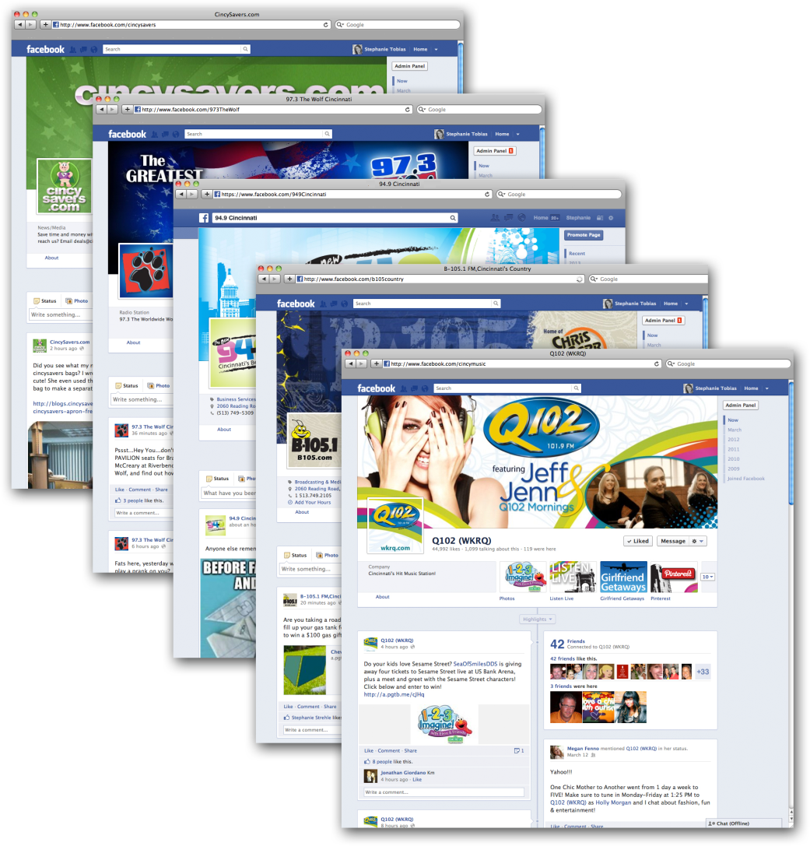
Why work with 2060 Digital? We have FRIENDS.
Over 155,000
people follow us
LOCALLY

Slide 8
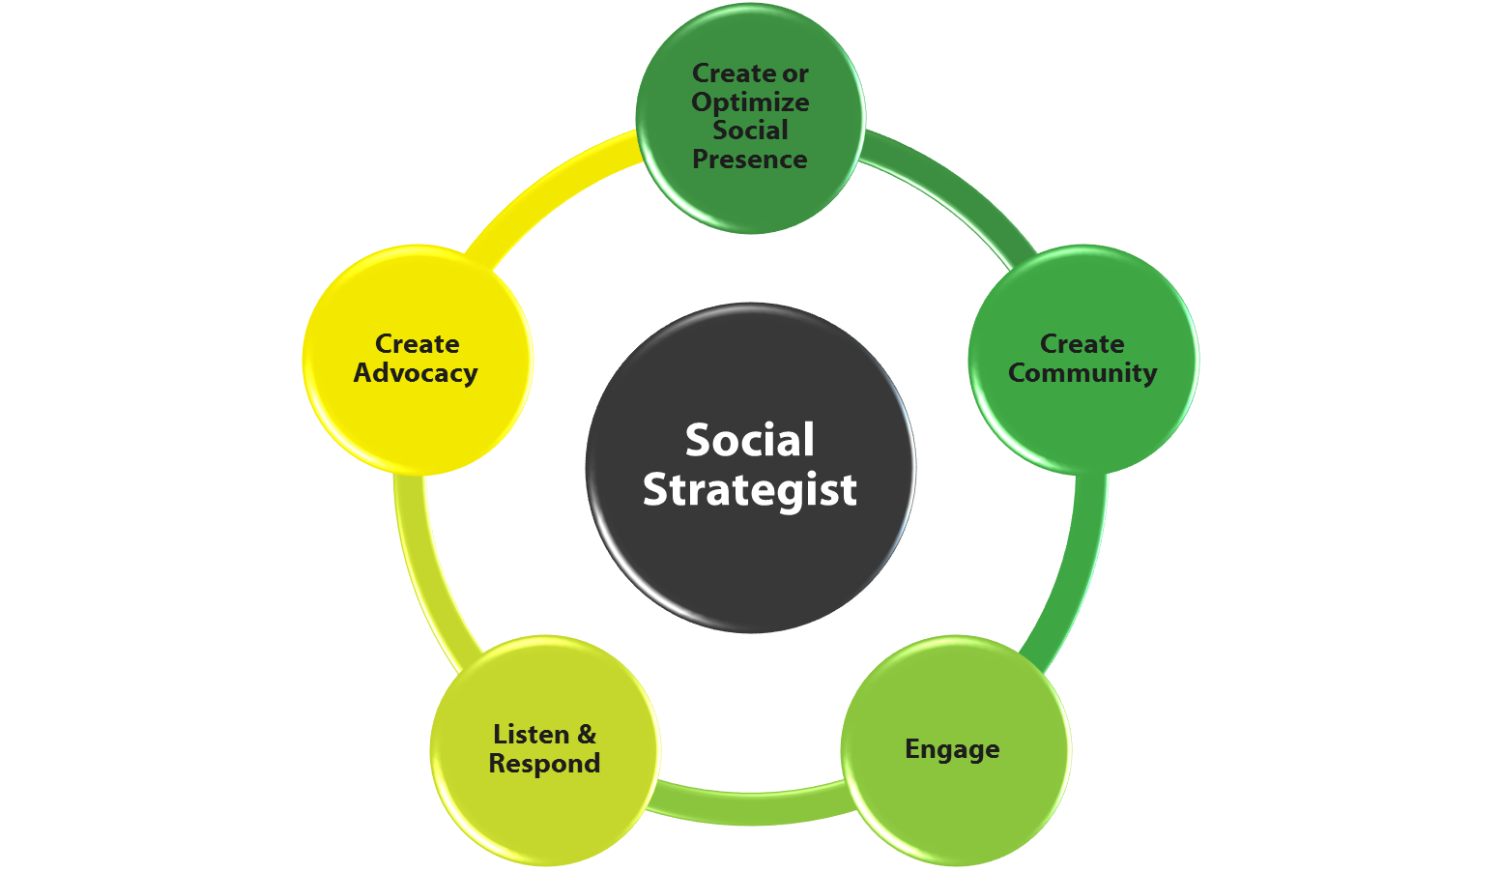
How We Do It
Assign Social Strategist
Create or Optimize Social Presence
Generate Followers
Targeted Ads
Organic conversation
Incentivize people
Engage Followers
Spark conversation 7 days a week
Respond & Listen
Reputation Management
Goals
Gain new customers
Customer retention
Create advocates for your business

Slide 9
What to Expect
Each brand is unique. Typically, a year-long campaign includes a combination of the following elements based on what will deliver the best results for your brand:
Customize
Optimize
Engage
Analyze
An initial planning meeting with your dedicated social media specialist and follow-up meetings as needed
Create a custom Facebook page highlighting your brand (or maximize the effectiveness of a current page)
Determine what supplementary social media to pursue (YouTube, Twitter, message boards, Yelp, LinkedIn, etc.); from there, we develop and carry out a plan for each of those pages to integrate to your Facebook hub (sending tweets, monitoring for retweets, etc.)
Communicate with your team on continued direction of social media, adapting as we see what works best for your brand
Partner with you to create a social media brand to carry out in your posts and content, consult with you about how to grow your follower base organically (by including social media signs at work stations, sending messages via your website or e-mail lists, promoting at your events or in your printed materials) and support you with text and graphics for key outreach efforts
Develop graphics for Facebook and other social media (profile images, etc.), e-blasts to invite your contact list to follow you on Facebook or on other social media, tabs within the Facebook interface showing off your promotions or contests
Take digitally produced video to use in social media efforts and more casual Flip video to supplement video efforts
Spread your reach and gain followers by supplementing with occasional targeted ad campaigns
Provide content management of your Facebook account (posting videos, photos, related comments, links, etc.)
Monitor your page and any other social media accounts determined at the initial meeting seven days per week, responding to questions or comments on your behalf and handling any irregular or negative activity on your page appropriately (for serious concerns, we will contact you immediately)
Promote your page from our cluster Facebook pages (Q102, B-105, Rewind 94.9, Wolf, cincysavers.com) and use “Like campaigns” to reach our followers, occasionally supplementing your promotions with station prizes (gift certificates, concert and move tickets, etc.)
Develop and manage contests and promotions from start to finish, including creating contest graphics, implementing the contest and entrant database and notifying and awarding prizes to winners
Monitor keywords related to your business for reputation management
Provide monthly reports detailing analytics and levels of engagement, including screen caps of posts, comments, posts on other third-party pages like message boards or Facebook groups, follower numbers, etc.

Slide 10
Benefits of Engaging in social media
Top of Mind Awareness Average person spends almost 7hours/month on Facebook (Nielsen)
Makes your brand relevant
Customer Service
Reputation Management
Generate Sales Leads
Mobile Smartphone users check Facebook 14x a day
New product ideas and feedback
Competitive information
Requests about company services
Consumers trust friends more than advertising: 70% of customers trust brand recommendations from friends (Mashable)
Word-of-mouth Marketing
SEO
Humanize your brand
Creates transparency

Slide 11
Social Media Management Levels
$3,900/mo. | $2,900/mo. | $1,900/mo.
Platinum Level | Gold Level | Silver Level
Setup fee: $1,000 | Setup fee: $750 | Setup fee: $750

Slide 12
Platinum Level: $3,900/month
Setup fee: $1,000
PRIMARY CHANNEL
Facebook
Dedicated social media strategist
Content creation – 5 posts/week
Page posting and monitoring (responding & addressing comments daily)
Introduce page to our 138,000 Facebook followers – 4 posts/month
Develop, manage and provide prizes for contests – up to 6/year ($200/contest in prizes)
Monthly strategy meetings [quarterly face to face; otherwise conference call]
Graphics – up to 6/year starting month 2 (1 cover photo, 1 profile photo)
Graphics for wall posts – 2/month
Apps – 1 every other month starting month 2 (4 basic, 2 advanced)
Hosting apps for length of contract*
Facebook targeted ad campaigns – $500/month
Event attendance (On-site photography, etc.) – 4 hours/quarter including travel time**
Monthly report
Initial Setup
In-person planning and strategy meeting
Optimize page (1 cover photo, 1 profile photo, app icons for existing apps)
1 app (basic)
ANNUAL PLATINUM LEVEL
AT A GLANCE:
3 social networks
6 Facebook contests/year
$500/month in Facebook targeted ads
7 Facebook apps
By signing below, you hereby agree to the terms of this Proposal, as well as the attached Terms and Conditions which are incorporated into the Proposal by this reference.
2060 Digital Signature: |  | Client Approval:
Date: |  | Date:
*Client will be provided app graphics for alternative means of hosting once contract is complete.
**Client will be billed $.565 per mile on any travel more than 50 miles roundtrip. Contract is a 12 month commitment starting with the initial strategy and planning meeting.

Slide 13
Platinum Level continued
TWO FOUNDATION CHANNELS ARE INCLUDED IN THE PLATINUM LEVEL – (Select Two)
Email Marketing
Create content and graphics for one email a month to client database*
Manage contacts gained from social
Monthly report
Twitter
Creation and optimization of account including background and profile image
Create a Twitter app that lives on client’s Facebook page
Content creation (repurposed from Facebook)
Page posting and monitoring (responding & addressing comments daily)
Keyword monitoring – up to 3 terms
Monthly report
YouTube
Creation and optimization of account including background and profile image
Create a YouTube app that lives on the client’s Facebook page
4 original videos per year** (up to 8 hours production per video)
Post and optimize videos supplied by client
Monthly report
Pinterest
Creation and optimization of account including profile image and company description
Create a Pinterest app that lives on client’s Facebook page
Creation of 8 customized pin boards
50 pins each month (combination of pins from client’s website and repins), each containing a link to the source and a short description/commentary
Monthly report
I will choose the two channels with my strategist.
Other network capabilities to be priced upon client request
By signing below, you hereby agree to the terms of this Proposal, as well as the attached Terms and Conditions which are incorporated into the Proposal by this reference.
2060 Digital Signature: |  | Client Approval:
Date: |  | Date:
*Client will be provided app graphics for alternative means of hosting once contract is complete.
**Client will be billed $.565 per mile on any travel more than 50 miles roundtrip. Contract is a 12 month commitment starting with the initial strategy and planning meeting.

Slide 14
Gold Level: $2,900/month Setup fee: $750
PRIMARY CHANNEL
Facebook
Dedicated social media strategist
Content creation – 5 posts/week
Page posting and monitoring (responding & addressing comments daily)
Introduce page to our 138,000 Facebook followers – 6 posts/quarter
Develop, manage and provide prizes for contests – up to 4/year ($150/contest in prizes)
Quarterly in-person strategy meetings
Graphics – up to 3/year starting month 2 (1 cover photo, 1 profile photo)
Graphics for wall posts – 2/month
Apps – 1 per quarter (3 basic, 1 advanced)
Hosting apps for length of contract*
Facebook targeted ad campaigns – $250/month
Monthly report
Initial Setup
In-person planning and strategy meeting
Optimize page (1 cover photo, 1 profile photo, app icons for existing apps)
ANNUAL GOLD LEVEL
AT A GLANCE:
2 social networks
4 Facebook contests/year
$250/month in Facebook targeted ads
4 Facebook apps
By signing below, you hereby agree to the terms of this Proposal, as well as the attached Terms and Conditions which are incorporated into the Proposal by this reference.
2060 Digital Signature: |  | Client Approval:
Date: |  | Date:
*Client will be provided app graphics for alternative means of hosting once contract is complete.
**Client will be billed $.565 per mile on any travel more than 50 miles roundtrip. Contract is a 12 month commitment starting with the initial strategy and planning meeting.

Slide 15
Gold Level continued
ONE FOUNDATION CHANNEL IS INCLUDED IN THE GOLD LEVEL – (Select One)
Email Marketing
Create content and graphics for one email a month to client database*
Manage contacts gained from social
Monthly report
Twitter
Creation and optimization of account including background and profile image
Create a Twitter app that lives on client’s Facebook page
Content creation (repurposed from Facebook)
Page posting and monitoring (responding & addressing comments daily)
Keyword monitoring – up to 3 terms
Monthly report
YouTube
Creation and optimization of account including background and profile image
Create a YouTube app that lives on the client’s Facebook page
4 original videos per year** (up to 8 hours production per video)
Post and optimize videos supplied by client
Monthly report
Pinterest
Creation and optimization of account including profile image and company description
Create a Pinterest app that lives on client’s Facebook page
Creation of 8 customized pin boards
50 pins each month (combination of pins from client’s website and repins), each containing a link to the source and a short description/commentary
Monthly report
I will choose the channel with my strategist.
Other network capabilities to be priced upon client request
By signing below, you hereby agree to the terms of this Proposal, as well as the attached Terms and Conditions which are incorporated into the Proposal by this reference.
2060 Digital Signature: |  | Client Approval:
Date: |  | Date:
*Client will be provided app graphics for alternative means of hosting once contract is complete.
**Client will be billed $.565 per mile on any travel more than 50 miles roundtrip. Contract is a 12 month commitment starting with the initial strategy and planning meeting.

Slide 16
Silver Level: $1,900/month Setup Fee: $750
PRIMARY CHANNEL
Facebook
Dedicated social media strategist
Content creation – 5 posts/week
Page posting and monitoring (responding & addressing comments daily)
Introduce page to our 138,000 Facebook followers – 8/year
Develop, manage and provide prizes for contests – up to 2/year ($150/contest in prizes)
Quarterly in-person strategy meetings
Graphics for wall posts – 2/month
Apps – 1 semi-annually (2 basic)
Hosting apps for length of contract*
Facebook targeted ad campaigns – $125/month
Quarterly report
Initial Setup
In-person planning and strategy meeting
Optimize page (1 cover photo, 1 profile photo, app icons for existing apps)
ANNUAL SILVER LEVEL
AT A GLANCE:
1 social network
2 Facebook contests/year
$125/month in Facebook targeted ads
2 Facebook apps
By signing below, you hereby agree to the terms of this Proposal, as well as the attached Terms and Conditions which are incorporated into the Proposal by this reference.
2060 Digital Signature: |  | Client Approval:
Date: |  | Date:
*Client will be provided app graphics for alternative means of hosting once contract is complete.
**Client will be billed $.565 per mile on any travel more than 50 miles roundtrip. Contract is a 12 month commitment starting with the initial strategy and planning meeting.

Slide 17
Materials to be supplied by Client. Client hereby agrees and commits to provide the prizes, content, and/or other materials and information set forth in the Social Media Marketing & Management Proposal (“Proposal”) and agreed upon by mutual agreement of the parties, as well as any additional materials reasonably requested by Hubbard Radio Cincinnati, LLC d/b/a 2060 Digital (hereinafter, “2060 Digital”), all in furtherance of the Agreement (the “Client Materials”).
Proprietary Rights. Client hereby grants 2060 Digital the right to use the Client Materials in connection with the development, creation, administration and use of Services, and to incorporate the Client Materials as necessary to fulfill the Services hereunder. All right, title and interest in the Client Materials shall, as between Client and 2060 Digital, remain the exclusive property of Client; and all right, title and interest in any intellectual property of 2060 Digital as of the Effective Date shall remain the intellectual property of 2060 Digital. 2060 Digital shall be allowed to include Client on 2060 Digital’s client list. Notwithstanding the foregoing, all right, title and interest in and to the phases, processes, measurements, systems, software, data, reports, databases, and other intellectual property produced, used or owned by 2060 Digital, or which were created in the development, creation, delivery and use of the Services, excluding the Client Materials, including any modifications, enhancements, or derivative works thereof, are and shall remain or become the exclusive property of 2060 Digital.
Representations and Warranties. Each party represents and warrants that it has the right and authority to enter into this Agreement.
Client’s Representations and Warranties. Client represents and warrants that (i) Client has all necessary rights and authority to grant 2060 Digital the right to use the Client Materials in connection with the development, creation, administration and use of Services, (ii) 2060 Digital’s use of the Client Materials in connection with the Services will not violate the rights of any third party, including but not limited to copyright, trademark, patent or other intellectual property or property right, (iii) Client shall advertise and conduct any Client-generated materials advertising a Promotion, if applicable, in accordance with the Promotion’s official rules and in accordance with all local, state and federal laws and regulations; and (iv) Client shall supply 2060 Digital with the Promotional elements, if applicable, as agreed to by the Parties in a timely manner.
2060 Digital’s Representations and Warranties. 2060 Digital represents and warrants that it shall structure, draft official rules and administer the Promotion, if applicable, in compliance with local, state and federal lottery laws and regulations.
Indemnification. Each party (the “Indemnifying Party”) shall defend, indemnify, and hold harmless the other party, and its parent, subsidiaries, affiliates, directors, officers, employees, agents and representatives (collectively, the “Indemnified Party”) from and against all claims, demands, suits, losses, damages, costs, and expenses (including without limitation reasonable attorneys’ fees) arising out of or relating to a third party claim or demand against the Indemnified Party arising out of or relating to (i) the negligent acts, omissions, or willful misconduct by the Indemnifying Party; (ii) the breach of any obligation, representation, or warranty hereunder by the Indemnifying Party; or (iii) the violation of any applicable law, statute or regulation by the Indemnifying Party.
Term & Termination. The Term of this Agreement shall begin on the date of signature set forth on the Signature Page of the Proposal, and shall continue until terminated by either party by providing the other party at least 30 days written notice of its wish to terminate.
Warranty Disclaimer. EXCEPT FOR THE EXPRESS REPRESENTATION AND WARRANTY SET FORTH IN SECTION 3 HEREOF, 2060 DIGITAL MAKES NO REPRESENTATIONS OR WARRANTIES, EXPRESS OR IMPLIED, WHETHER WRITTEN OR ORAL, EITHER IN FACT OR BY OPERATION OF LAW, BY STATUTE, OR OTHERWISE, UNDER THIS AGREEMENT AND CLIENT SPECIFICALLY WAIVES ANY CLAIM IT HAS OR MAY HAVE IN THE FUTURE AGAINST 2060 DIGITAL FOR BREACH OF ANY TYPE OF WARRANTY, INCLUDING WITHOUT LIMITATION, MERCHANTABILITY OR FITNESS FOR A PARTICULAR PURPOSE. 2060 DIGITAL DOES NOT GUARANTEE ANY SPECIFIC RESULTS OF THE SERVICES PROVIDED HEREUNDER WILL BE ERROR FREE OR UNINTERRUPTED.
Limitation of Liability. NEITHER PARTY WILL BE LIABLE FOR ANY SPECIAL, INDIRECT, PUNITIVE, OR CONSEQUENTIAL DAMAGES, ARISING OUT OF OR RELATED TO THIS AGREEMENT AND THE SERVICES PROVIDED HEREUNDER, EVEN IF THE PARTIES HAVE KNOWLEDGE OF THE POSSIBILITY OF SUCH DAMAGES AND WHETHER OR NOT SUCH DAMAGES ARE FORESEEABLE.
Force Majeure. Except for the obligation to make payments, nonperformance of either party shall be excused to the extent that such performance of contractual obligations is rendered impossible or impractical, either totally or in part, by any acts of God, strike, governmental acts or orders or restrictions, war, acts of terrorism, failure of suppliers, network or telecommunications outage, or any other reason where failure to perform is beyond the reasonable control of the non-performing party (collectively, “Force Majeure”). A Force Majeure event shall have the effect of suspending the obligations of the party which has invoked the provisions of this Section to the extent such obligations are affected by the Force Majeure.
Privacy. 2060 Digital guarantees that all information relating to the Services which is acquired by 2060 Digital, including but not limited to entrants personally identifiable information, will be held as confidential within 2060 Digital and will not be shared with any third party, and shall be held in conformity with all applicable laws and regulations.
Miscellaneous.
The parties understand and agree that 2060 Digital shall perform all services hereunder as an independent contractor, and that this Agreement does not create a joint venture, partnership, employment or agency relationship between 2060 Digital and Client.
This Agreement may not be assigned by Client without the prior written consent of 2060 Digital. This Agreement shall be binding upon and inure to the benefit of the parties, and their respective successors and permitted assigns.
This Agreement constitutes the entire agreement between 2060 Digital and Client with respect to the subject matter hereof.
All notices, consents and other communications hereunder must be in writing and will be deemed to have been duly given when delivered to the other party at the address provided herein.
This Agreement shall be construed in accordance with the laws of the State of Ohio without regard to conflict of law principles.
If any provision herein shall be deemed or declared unenforceable, invalid or void by a court of competent jurisdiction, the same shall not impair any of the other provisions contained herein which shall be enforced in accordance with their respective terms.
No failure or delay by either party hereto to exercise any right, power or privilege provided hereunder or by applicable law shall operate as a waiver thereof. The remedies provided herein shall be cumulative and shall not be exclusive of any rights or remedies provided by law.
2060 Digital does not discriminate in the sale of advertising time, and will accept no advertising which is placed with an intent to discriminate on the basis of race or ethnicity. Client hereby certifies that it is not buying broadcasting air time under this Agreement for a discriminatory purpose, including but not limited to decisions not to place advertising on particular stations on the basis of race, national origin or ancestry.
Sections 2, 3, 4, 5, 6, 7, 9, and 10 will survive termination or expiration of this Agreement.

